Slide 1
Multiples of 10 involving negative exponents
Standard form

Slide 2
How our teaching resources are designed for the classroom

Slide 3
I can write any integer in a range of forms.

Slide 4
When a number is multiplied by itself multiple times, it can be written more simply in exponential form.
E.g. 2 × 2 × 2 = 2³

Slide 5

Multiples of 10 involving negative exponents
Introducing negative exponents
Writing integers in a range of forms

Slide 6
Introducing negative exponents
What does 4⁵ mean?
An exponent tells us how many identical values must be multiplied together.
4⁵ = 4 × 4 × 4 × 4 × 4
You have seen exponents being used with square and cube numbers.
We have also seen exponents when considering place value.

Slide 7






Introducing negative exponents
Th | H | T | O | t | h | th
1000 | 100 | 10 | 1
10 × 10 × 10 | 10 × 10 | 10 | 1
10³ | 10² | 10¹ | 10⁰
If we can write 1000, 100 and 10 in exponent form, surely we can write the others in exponent form too.
I think you must be right.
Lucas
Aisha

Slide 8
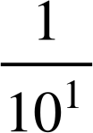
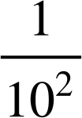
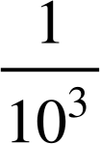
Introducing negative exponents
=
=
=
=
×
=
=
×
×
Exponent form means a repeated multiplication. What repeated multiplications have happened here?
We can rewrite these as …
Well, we know that 10 can also be written as 10¹, 100 as 10² and 1000 as 10³.
Lucas
Aisha

Slide 9
Introducing negative exponents
Th | H | T | O | t | h | th
1000 | 100 | 10 | 1
10 × 10 × 10 | 10 × 10 | 10 | 1
10³ | 10² | 10¹ | 10⁰
×
×
×
The exponents decrease as you move right but when you get to the decimal parts it becomes the reciprocal.
The exponents are decreasing by one each time. Could be written as 10⁻¹?
Oh right. Did you notice anything?
I was looking at the exponential column headings.
Lucas
Aisha

Slide 10
Introducing negative exponents
Number | Exponential form
1000 | 10³
100 | 10²
10 | 10¹
1 | 10⁰
0.1
0.01
0.001
0.0001
Number | Exponential form
1000 | 10³
100 | 10²
10 | 10¹
1 | 10⁰
0.1 | 10⁻¹
0.01 | 10⁻²
0.001 | 10⁻³
0.0001 | 10⁻⁴
Continuing the pattern it goes, 10⁻¹, 10⁻², 10⁻³, etc.
Lucas
Aisha

Slide 11

Introducing negative exponents
Number | Fractional form | Exponential form
0.1 |  | 10⁻¹
0.01 |  | 10⁻²
0.001 |  | 10⁻³
0.0001 |  | 10⁻⁴

Slide 12
Introducing negative exponents
That must mean that and 10⁻² are equivalent.
Which makes sense as 10² is 100
Lucas
Aisha

Slide 13
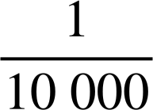
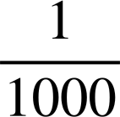
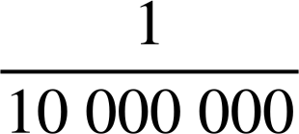

Introducing negative exponents
Match the fractional forms to the exponential form:
10⁻³
10⁻¹
10⁻⁴
10⁻⁷

Slide 14

Introducing negative exponents
0 | t | h | th | tth | hth
1
10⁰ | 10⁻¹ | 10⁻² | 10⁻³ | 10⁻⁴ | 10⁻⁵
1
1
Let’s take a look at how everything is linked. We’ll start with the integer 1
I move the digit 1 one place to the right.
What have I done to the 1?
1 ÷ 10
The 1 is now in the tenths column.
Therefore 0.1 = 1 ÷ 10 = = 1 × 10⁻¹

Slide 15
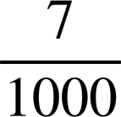
Introducing negative exponents
Let’s try this with some simple decimals first.
E.g. 0.007
0 | t | h | th | tth | hth
1
10⁰ | 10⁻¹ | 10⁻² | 10⁻³ | 10⁻⁴ | 10⁻⁵
0
0
0
7
0.007
= 7 ×
=
= 7 × 10⁻³

Slide 16
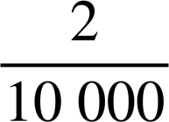
Introducing negative exponents
Let’s try this with some simple decimals first.
E.g. 0.0002
0 | t | h | th | tth | hth
1
10⁰ | 10⁻¹ | 10⁻² | 10⁻³ | 10⁻⁴ | 10⁻⁵
0
0
0
0
2
0
0.0002
= 2 ×
=
= 2 × 10⁻⁴

Slide 17
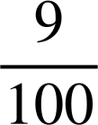
Introducing negative exponents
Write 0.09 in expanded exponential form.
0 | t | h | th | tth | hth
1
10⁰ | 10⁻¹ | 10⁻² | 10⁻³ | 10⁻⁴ | 10⁻⁵
0
0
9
0.09
= 9 ×
=
= 9 × 10⁻²

Slide 18
Introducing negative exponents
Previously you will have used a place value grid to write numbers in their expanded form.
E.g. 8349
HTh | TTh | Th | H | T | O
10⁵ | 10⁴ | 10³ | 10² | 10¹ | 10⁰
HTh | TTh | Th | H | T | O
10⁵ | 10⁴ | 10³ | 10² | 10¹ | 10⁰
 |  | 8 | 3 | 4 | 9
8 × 10³ + 3 × 10² + 4 × 10¹ + 9 × 10⁰

Slide 19
Introducing negative exponents
Previously you will have used a place value grid to write numbers in their expanded form.
E.g. 20 586
HTh | TTh | Th | H | T | O
10⁵ | 10⁴ | 10³ | 10² | 10¹ | 10⁰
HTh | TTh | Th | H | T | O
10⁵ | 10⁴ | 10³ | 10² | 10¹ | 10⁰
 | 2 | 0 | 5 | 8 | 6
2 × 10⁴ + 5 × 10² + 8 × 10¹ + 6 × 10⁰

Slide 20
Introducing negative exponents
What is this number?
2 × 10⁶ + 9 × 10⁴ + 5 × 10² + 8 × 10⁰
Lucas writes 2958
What mistake has Lucas made?
He has just written the digits 2, 9, 5 and 8 and not considered the place value of each digit.
It should be 2 090 508

Slide 21
Introducing negative exponents
Now let’s extend this to decimals.
E.g. 0.0487
0 | t | h | th | tth | hth
1
10⁰ | 10⁻¹ | 10⁻² | 10⁻³ | 10⁻⁴ | 10⁻⁵
0
0
4
8
7
0.0487
= 4 × 10⁻² + 8 × 10⁻³ + 7 × 10⁻⁴

Slide 22
Introducing negative exponents
E.g. 0.00104
0 | t | h | th | tth | hth
1
10⁰ | 10⁻¹ | 10⁻² | 10⁻³ | 10⁻⁴ | 10⁻⁵
0
0
0
1
0
4
0.00104
= 1 × 10⁻³ + 4 × 10⁻⁵

Slide 23
Introducing negative exponents
Match the decimal to its correct expanded form.
0.023
2 × 10⁻¹ + 3 × 10⁻²
0.203
2 × 10⁻³ + 3 × 10⁻⁴
0.0023
2 × 10⁻¹ + 3 × 10⁻³
0.00203
2 × 10⁻² + 3 × 10⁻³
0.23
2 × 10⁻³ + 3 × 10⁻⁵

Slide 24
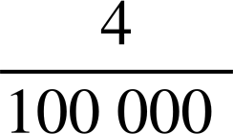

Introducing negative exponents
Fill in the gaps:
 | Decimal | Fraction | Exponential Form
a | 0.09
b
c |  |  | 3 × 10⁻¹
d
e | 0.0007
f |  |  | 8 × 10⁻⁶
g
h |  |  | 5 × 10⁻⁴

Slide 25
Introducing negative exponents
2) What mistake has Aisha made?
Write 0.0003 in expanded exponential form.
Aisha writes:
0.0003 = 3 × 10⁻³ because there are 3 zeros after the decimal point.
Aisha

Slide 26
Introducing negative exponents
3) Write each of the following in the alternative format:
 | Decimal | Exponential form
a | 0.34
b |  | 5 × 10⁻¹ + 2 × 10⁻²
c |  | 4 × 10⁻² + 7 × 10⁻³ + 3 × 10⁻⁴
d | 0.049
e | 0.000603
f |  | 2 × 10⁻¹ + 3 × 10⁻⁴ + 3 × 10⁻⁶
g | 17.02
h |  | 2 × 10² + 3 × 10⁻¹ + 5 × 10⁻³ + 8 × 10⁻⁴

Slide 27

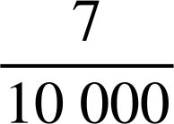
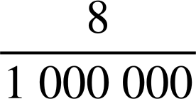
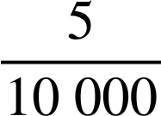
Introducing negative exponents
Fill in the gaps:
 | Decimal | Fraction | Exponential Form
a | 0.09 |  | 9 × 10⁻²
b | 0.00004 |  | 4 × 10⁻⁵
c | 0.3 |  | 3 × 10⁻¹
d | 0.2 |  | 2 × 10⁻¹
e | 0.0007 |  | 7 × 10⁻⁴
f | 0.000008 |  | 8 × 10⁻⁶
g | 0.007 |  | 7 × 10⁻³
h | 0.0005 |  | 5 × 10⁻⁴

Slide 28
Introducing negative exponents
2) What mistake has Aisha made?
Write 0.0003 in expanded exponential form.
Aisha writes:
0.0003 = 3 × 10⁻³ because there are 3 zeros after the decimal point.
The 3 is in the ten thousandths column.
10⁻³ is one thousandth not one ten thousandth.
Therefore, the answer should be 3 × 10⁻⁴
Aisha

Slide 29
Introducing negative exponents
3) Write each of the following in the alternative format:
 | Decimal | Exponential form
a | 0.34 | 3 × 10⁻¹ + 4 × 10⁻²
b | 0.52 | 5 × 10⁻¹ + 2 × 10⁻²
c | 0.0473 | 4 × 10⁻² + 7 × 10⁻³ + 3 × 10⁻⁴
d | 0.049 | 4 × 10⁻² + 9 × 10⁻³
e | 0.000603 | 6 × 10⁻⁴ + 3 × 10⁻⁶
f | 0.200303 | 2 × 10⁻¹ + 3 × 10⁻⁴ + 3 × 10⁻⁶
g | 17.02 | 1 × 10¹ + 7 × 10⁰ + 2 × 10⁻²
h | 200.3058 | 2 × 10² + 3 × 10⁻¹ + 5 × 10⁻³ + 8 × 10⁻⁴

Slide 30
Multiples of 10 involving negative exponents
Introducing negative exponents
Writing integers in a range of forms

Slide 31

Writing integers in a range of forms
How many different ways can you write 6300?
E.g. 63 × 100
Keeping 63, how else could this be written?
63 × 10 × 10
63 × 10²
What about if I change the 63 to 6.3?
6.3 × 1000
6.3 × 10 × 10 × 10
6.3 × 10³
There are an infinite number of ways of writing any integer.
× 10³

Slide 32


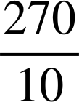

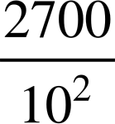
Writing integers in a range of forms
Which of the following are alternative ways of writing 27 000?
2 700 000 × 10⁻²
× 10⁴
27 × 10³
× 100 000
2.7 × 10³
27 × 10
0.27 × 10⁵
2.7 × 10 000
× 10³
We will look at some of the more challenging ones now.

Slide 33
Writing integers in a range of forms
× 10⁴
We can rewrite this as: 27 ÷ 10 × 10 000
= 2.7 × 10 000
= 27 000

Slide 34
Writing integers in a range of forms
2.7 × 10³
We can rewrite this as: 2.7 × 1000
= 2700

Slide 35
Writing integers in a range of forms
× 10³
We can rewrite this as: 2700 ÷ 100 × 1000
= 27 × 1000
= 27 000

Slide 36
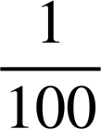
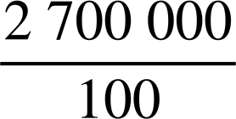
Writing integers in a range of forms
2 700 000 × 10⁻²
We can rewrite this as: 2 700 000 ×
= 2 700 000 ×
=
= 27 000

Slide 37
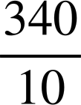
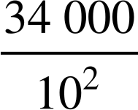
Writing integers in a range of forms
Which of the following are alternative ways of writing 340?
3.4 × 10²
3.4 × 100 = 340
× 10
340 ÷ 10 × 10 = 340
34 000 ÷ 100 = 340
34 000 × 10⁻²
× 10⁻¹
34 000 ÷ 100 ÷ 10 = 34

Slide 38

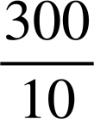
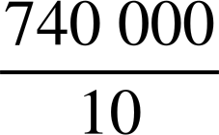
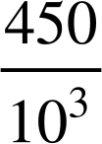
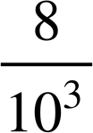
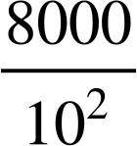
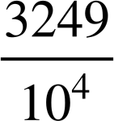
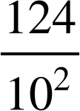
Writing integers in a range of forms
Identify the incorrect alternative in each row. Record the letter and rearrange them to make a word.
Number | Alternative 1 | Alternative 2 | Alternative 3 | Alternative 4
3000 | 3 × 10⁴ | 3 × 10² × 10 | × 10³ | × 10²
74 000 | 7.4 × 10⁴ | 74 × 10³ | 7.4 × 10³
120 000 | 12 × 10² × 10² | 1.2 × 10⁵ | 1.2 × 10⁴ | 1.2 × 10⁶ × 10⁻¹
450 | 4500 × 0.1 | × 10³ | 4.5 × 10² | 4.5 × 10⁻²
8 000 000 | 8 × 10³ × 10³ | × 10⁸ | 8 × 10⁶ | × 10⁵
628 000 | 6 280 000 × 10⁻¹ | 6.28 × 10⁵ | 6.28 × 10³ | 628 × 10³
32 490 | 32.49 × 10² | 324.9 × 10² | × 10⁵ | 324 900 × 10⁻¹
12 400 000 | 12.4 × 10⁻³ × 10⁹ | × 10⁷ | 1.24 × 10⁷ | 124 × 10⁻² × 10⁶
N
L
I
Y
A
P
X
C
R
H
E
B
S
E
F
O
T
P
V
D
O
D
N
P
E
M
A
H
N
L
O
T

Slide 39
Writing integers in a range of forms
Identify the incorrect alternative in each row. Record the letter and rearrange them to make a word. EXPONENT
Number | Alternative 1 | Alternative 2 | Alternative 3 | Alternative 4
3000 | 3 × 10⁴ | 3 × 10² × 10 | × 10³ | × 10²
74 000 | 7.4 × 10⁴ | 74 × 10³ | 7.4 × 10³
120 000 | 12 × 10² × 10² | 1.2 × 10⁵ | 1.2 × 10⁴ | 1.2 × 10⁶ × 10⁻¹
450 | 4500 × 0.1 | × 10³ | 4.5 × 10² | 4.5 × 10⁻²
8 000 000 | 8 × 10³ × 10³ | × 10⁸ | 8 × 10⁶ | × 10⁵
628 000 | 6 280 000 × 10⁻¹ | 6.28 × 10⁵ | 6.28 × 10³ | 628 × 10³
32 490 | 32.49 × 10² | 324.9 × 10² | × 10⁵ | 324 900 × 10⁻¹
12 400 000 | 12.4 × 10⁻³ × 10⁹ | × 10⁷ | 1.24 × 10⁷ | 124 × 10⁻² × 10⁶
N
L
I
Y
A
P
X
C
R
H
E
B
S
E
F
O
T
P
V
D
O
D
N
P
E
M
A
H
N
L
O
T

Slide 40
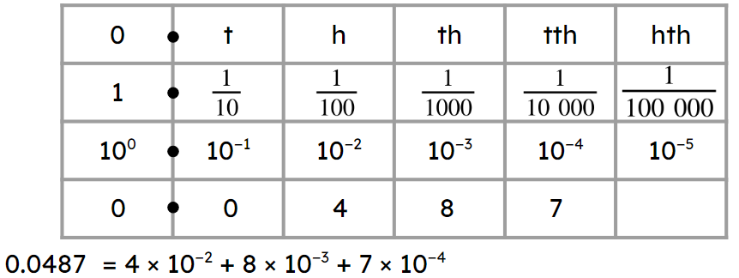
Multiples of 10 involving negative exponents
Exponential column headings in a place value chart can be extended to the decimal parts.
10⁻² = 0.01 =
Integers can be written in a range of forms.
E.g. 450 = 4500 × 0.1 = 4500 × = 4500 × 10⁻¹ = × 10³

Slide 41

© Oak National Academy 2024.
Produced in partnership with Mathematics in Education and Industry.
Licensed on the Open Government Licence v3.0, except where otherwise stated. See Oak terms and conditions.

